Slide 1
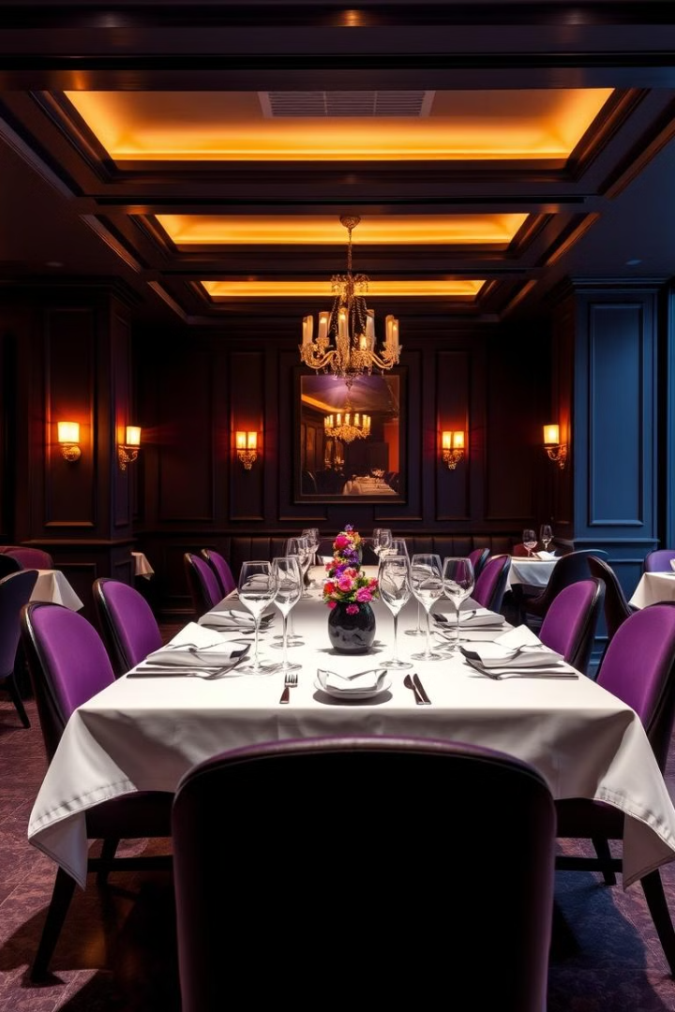
Online Restaurant Table Booking System
Streamlining the reservation process, empowering customers, and optimizing restaurant operations - an online table booking system is the key to elevating the dining experience.
by Ajay.ch (192210473)
Y. Sasi Kumar (192210474)

Slide 2

The Problem: Inefficient Reservation Management
1
Long Waitlists
2
Missed Opportunities
Manual booking processes lead to confusion, overbooking, and frustrated customers.
Inefficient systems prevent restaurants from maximizing seat turnover and revenue.
3
Strained Operations
Struggling to coordinate seating, server assignments, and table management.

Slide 3
Key Features of a Modern Booking System
Real-time Availability
Customized Experiences
Seamless Integration
Customers can instantly view open tables and make reservations with ease.
Collect guest preferences to suggest menu items and accommodate special requests.
Sync with POS systems to manage waitlists, seating, and table turnover.

Slide 4
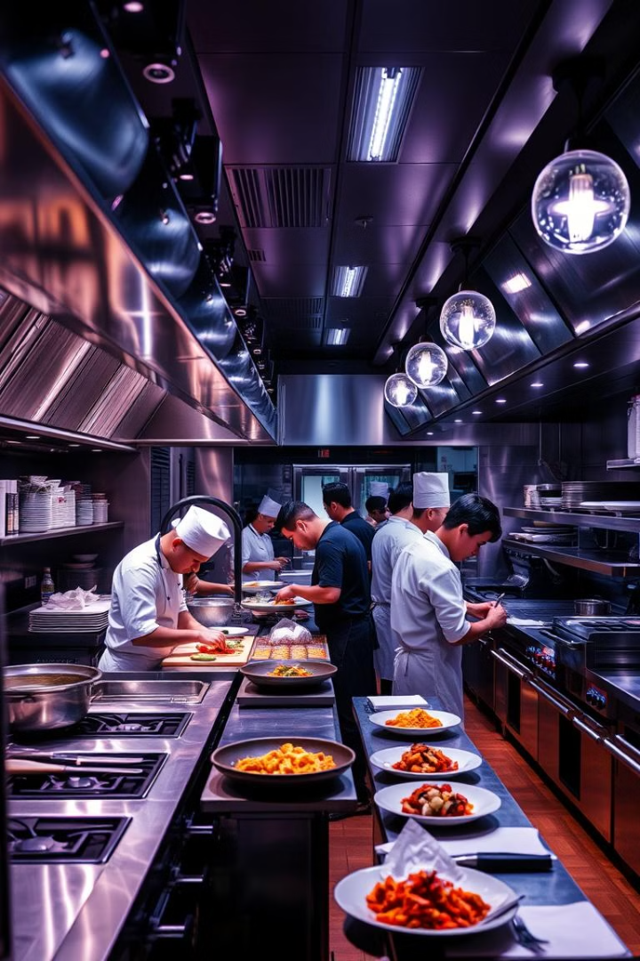
Seamless Integration with Restaurant Operations
Waitlist Management
Optimized Seating
Automatically update waitlist and notify guests when their table is ready.
Dynamically assign tables based on party size, dietary needs, and server availability.
Detailed Reporting
Gain insights into peak hours, table turnover, and revenue to inform business decisions.

Slide 5




Improved Guest Experience and Satisfaction
Reduced Waits
Personalized Service
Positive Reviews
Customers can book in advance, minimizing frustrating delays.
Anticipate preferences and cater to individual needs for a memorable visit.
Satisfied guests are more likely to return and recommend the restaurant.

Slide 6

Streamlining the Booking Process
1
Search
Customers can easily find and browse available reservation slots.
2
Select
Choose the desired date, time, and party size to secure their booking.
3
Confirm
Receive instant confirmation and any relevant details about their reservation.

Slide 7
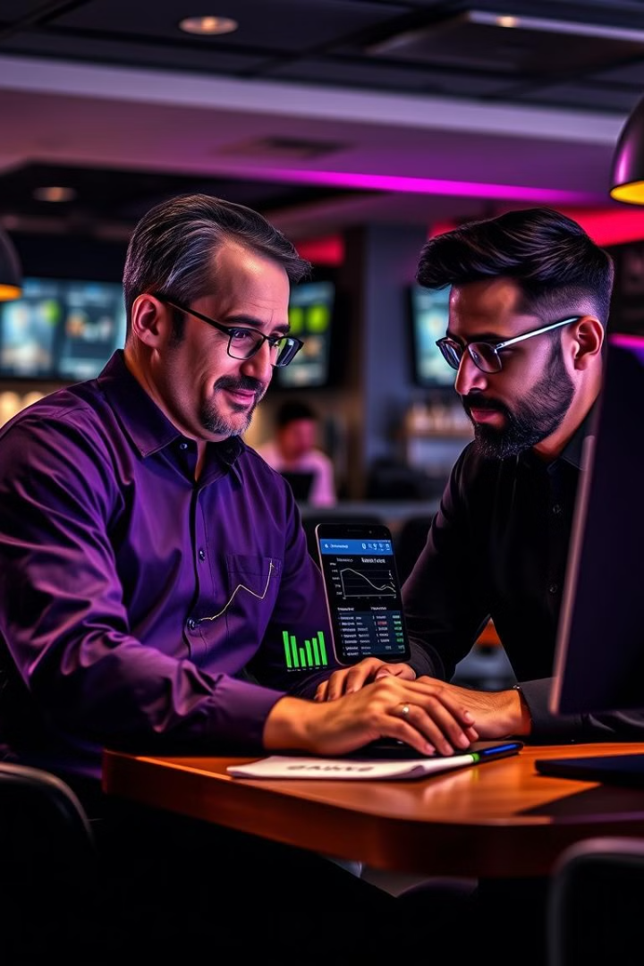
Driving Business Growth
30%
Increased Revenue
Maximize table turnover and seat utilization to boost overall profitability.
25%
Reduced No-shows
Automated reminders and cancellation policies decrease last-minute no-shows.
20%
Repeat Bookings
Exceptional experiences encourage customers to return and dine again.

Slide 8
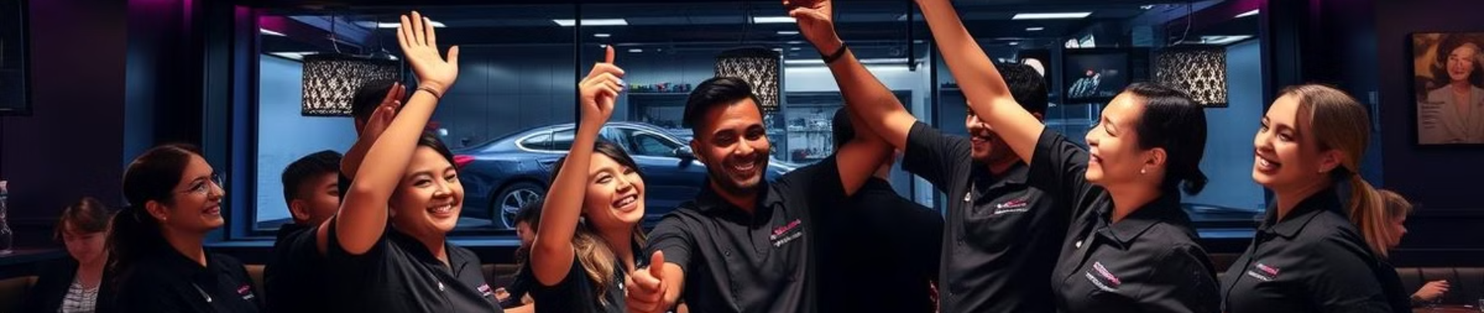
Conclusion
An online table booking system revolutionizes the dining experience for both restaurants and customers. By streamlining reservations, optimizing operations, and enhancing guest satisfaction, restaurants can drive growth, increase efficiency, and cement their reputation as a premier dining destination.

